Slide 1


while (1) {
wakeup();
coffee(“strong”);
program();
sleep(8 * 3600);
}
Programming Committee
TCC
STEM Center

Slide 2
Goals
Learn various languages and software tools in committee meetings
Concepts and languages = building blocks
Tools to succeed in future
Collaborate with peers
Useful projects and necessary skills
Fun
Resumé builder

Slide 3
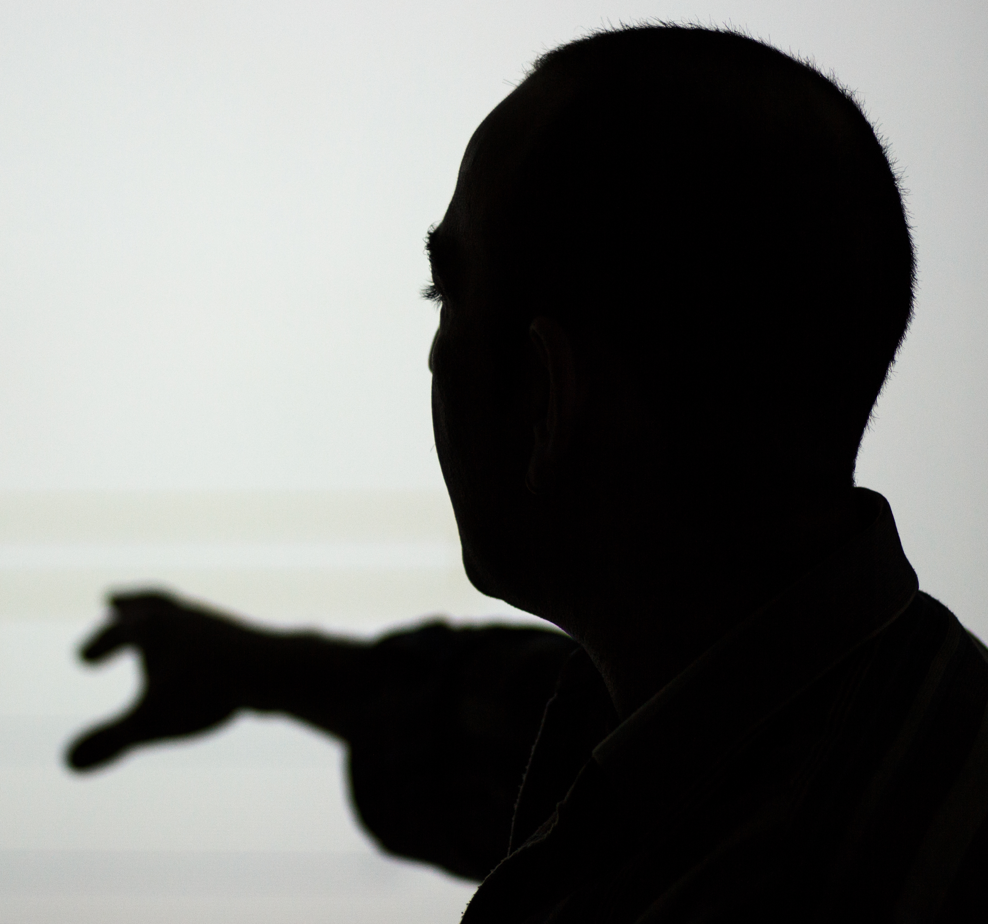

Committee Meetings

Slide 4
First Steps
Learn fundamental programming concepts in python
first online then locally
Learn about git, github, and source control management (scm)
Collaboration

Slide 5
Next Steps
Anyone can teach!
Robot C
Software tools
Other programming languages
My bag o’ tools:
Web development
3D modelling & 3D printing software
Linux/Unix (command-line tools)
Various programming languages

Slide 6



Road to Success

Slide 7
What to Know
All you need to know is the time and place of the meetings:
Thursdays @ 3pm EST in STEM Center
First meeting:
Thursday, October 5, 3pm EST

Slide 8

Collaboration

Slide 9
Collaborative Projects
In addition to committee meetings, collaborative projects will also be created and worked on by committee participants
Goal: work on useful or fun (or both) projects to reinforce programming skills and also to help with outreach, etc
Where and how will this take place?
GitHub!
Some Thursdays = collaboration days?
Great thing about git: work = any time!

Slide 10
GitHub
Method to the madness:
So many companies have migrated or started using git
GitHub allows us to host source code for free
Useful tool to put on resumé/CV
Very useful tool to know
Did I mention that it’s useful?

Slide 11
GitHub Infrastructure
Email: TccStemCenter@protonmail.ch
User: https://github.com/TccStem
Org: https://github.com/TccStemCenter

Slide 12

Conclusion

Slide 13
Conclusion
The dream:
Interactive, collaborative, fun, useful
Reality:
Self-motivation, commitment, interactive, collaborative, fun, useful

